Slide 1
METRUM RESEARCH GROUP
RESEARCH AND ANALYTICS CAPABILITIES DELIVERED BY GLUE ADVERTISING, LLC
April 29, 2024

Slide 2
INTRODUCTION
2

Slide 3

BIG-AGENCY THINKING
WITHOUT THE BIG AGENCY
Founders
Alan Rothenberg and Cindy Machles
3

Slide 4
www.glueadvertising.com
BIG-AGENCY THINKING
WITHOUT THE BIG AGENCY
HANDS-ON SENIOR LEADERS who foster a
client-first culture and really work your business
BEST-PRACTICE IMPROVEMENTS that take what works from big agencies and eliminate what doesn’t
HIGH-QUALITY WORK on time and on budget
RESULTS-ORIENTED with a focus on metrics
SPECIALISTS IN REGULATED INDUSTRIES including healthcare, where precision is paramount
CERTIFIED as a diverse supplier by the
Founders
Alan Rothenberg and Cindy Machles
4

Slide 5

GLUE HAS BEEN A TOP 20 NYC AGENCY OUT OF A FIELD OF 2000 SINCE 2017
One of the criteria is that we go beyond satisfaction to “delight our clients”—which makes us especially proud
5

Slide 6




OUR COMPETENCIES ARE FAR-RANGING
Branding
Insights, Mission/Vision, Positioning, Messaging, Architecture,
Employee Value Proposition,
Culture, Personal/Corporate/
Product, Market Research*
Design
Creative Strategy, Logos, Sound, Visual Systems, Interactive Design, Animation, Packaging, Pill Color and Shape
Innovation
Growth Strategy, Forecasting, Prototyping, Piloting
Experiences
Events and Environments, Moments that Matter, UI/UX, Employee Engagement and Retention
Advertising/PR
Creative Campaigns, Broadcast, Video, Print, Selling Materials, Websites, SEO/SEM, Social Media, Influencer Programs, Media Outreach, Language Translation, Analytics, Tracking Studies. Media Planning and Buying
Strategic Partnerships
Alternative Revenue Models, Stakeholder Relationship Building, Acquisition Efforts
Glue divisions include: Advertising/Branding, Public Relations, Market Research/Analytics, and Partnerships/Events
6

Slide 7





OUR SERVICE LEVEL AGREEMENT (sla)—AND EVERYDAY COMMITMENT TO YOU
ACCOUNT SERVICES | Deliver contact reports within 24 hours Respond to client calls and emails usually within an hour and always before end of day Provide status reports weekly Provide vacation schedules and coverage plans with advance notice of 2 weeks
CREATIVE AND TACTICAL DEVELOPMENT | Provide creative briefs and project briefs and gain client approval to them before work begins Ensure that creative and tactics adhere to branding guidelines and include executional mandatories Propose a quantity and range of options that align with approved briefs
PROJECT MANAGEMENT | Scope projects with attention to detail and accuracy Adhere to client review and approval processes Provide timelines and estimates at time of project initiation Update timelines within 24 hours of the occurrence of an unavoidable delay Commence work only after estimates are approved
FINANCIAL MANAGEMENT | Conform invoices and billing practices to client standards Final bill only after client satisfaction is confirmed Issue reconciliations every 30 days
CHANGE ORDERS | Prepare and deliver change orders immediately after a project-related assumption changes Brief the client on the rationale for changes and how associated costs were calculated
7

Slide 8
PROPOSED PROCESS
8

Slide 9
AGENCY process
COMPETITIVE ASSESSMENT
OPPORTUNITY ANALYSIS
PRICING AND FORECASTING
OMNICHANNEL IMPLEMENTATION
Landscape review and insight generation
Growth assessment and prioritization
Portfolio, price, and sales optimization
Plan of action, including strategies and tactics
9

Slide 10
Success Metrics are always front and center
For all engagements, we align with our clients on what they are looking to achieve as a result of research so that we can customize our process accordingly. Below are metrics that are commonly considered. Typically, there are 4-6 focus areas overall:
External: awareness, relevance, consideration, preference, likelihood to recommend, NPS
Internal: understanding and appreciation of culture, emotional connection to the organization and its people, acquisition and retention of employees, overall morale, willingness to recommend the organization to others
Business: inquiries, conversion, revenue, expanded footprint
10

Slide 11
COMPETITIVE ASSESSMENT
ACTIVITIES
Review currently available background materials
Undertake competitive and trends analyses based on information in the public domain
Conduct qualitative interviews to uncover journey and competitive-related insights, including current and potential customer perspectives on brand equities, service offerings, potential unmet needs, and pricing strategies
Synthesize and present findings
DELIVERABLES
Understanding of attitudes and behaviors from early discovery to conversion and loyalty, including pain points and levers available to be pulled along the way
At-a-glance dashboards that showcase how each competitor presents itself (see Appendix for samples for a B2B client)
Perceptual map, including parameters most often used for discrimination
First thoughts on ways that Metrum Research Group can meaningfully stand apart
11

Slide 12
GAP ANALYSIS
ACTIVITIES
Apply learnings to date to create stimuli appropriate for a MaxDiff quantitative survey
Based on those findings, identify areas of Metrum Research Group overperformance and underperformance at the Parent Level (e.g. awareness, reputation, thought leadership, etc.) and the service/solutions levels (e.g. relevance, quality, reliability, etc.) and the underlying perceptual and tangible reasons why
Overlay “importance” on performance to begin prioritizing where action should be taken
Synthesize and present findings
DELIVERABLES
Attitudes and behaviors toward Metrum Research Group and the services and solutions it offers; where there is a preference, the drivers of such
Hypotheses on where Metrum Research Group should focus to meet share and growth objectives, with pricing and forecasting still to be considered
12

Slide 13
PRICING AND FORECASTING
ACTIVITIES
Field a conjoint-based survey to reveal the preference share of products and services (offered by Metrum Research Group and competitors) by understanding the value of the attributes that comprise them
Translate preference share into potential market share with a simulator that takes into consideration real-world factors such as aided and unaided awareness, imagery, stature, and vitality, all gleaned during the Gap Analysis step, as well as a variety of pricing scenarios
Synthesize and present findings
DELIVERABLES
An evergreen model that can forecast multiple years of sales at varying price points, assuming that products and services with unique/compelling features do not enter and upend the market
Note: While the sample forecasting/pricing model that we are sharing (see next slide) is product specific, it shows different opportunities for product use by target audience vs. competitors, which we believe is analogous to what you are looking to learn. This product was recalled from the market by the FDA, which eliminates confidentiality considerations.
13

Slide 14
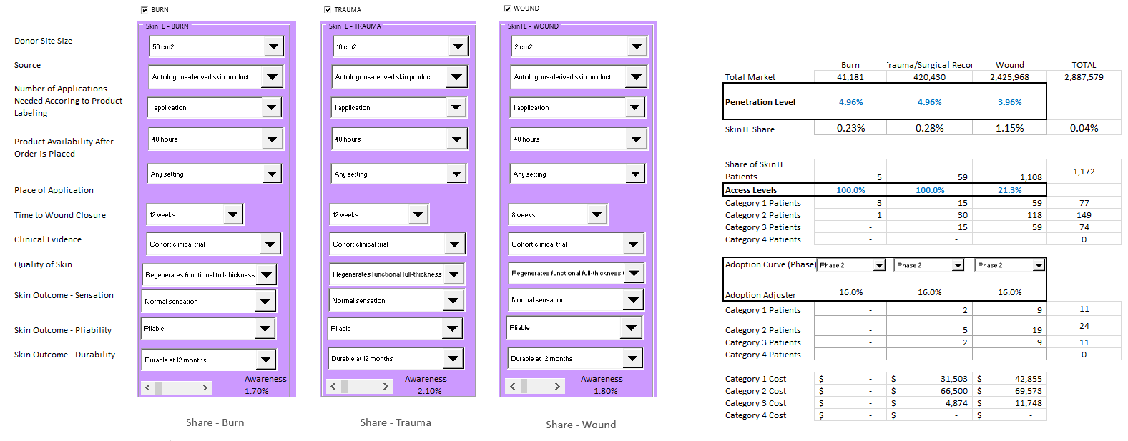
skinTE pricing and forecasting model: By use case
14

Slide 15
OMNICHANNEL IMPLEMENTATION
ACTIVITIES
Deliver a brand plan based on the Procter & Gamble OGSMT model—objectives, goals, strategies, metrics, tactics
DELIVERABLES
Brand plan, as described, that includes details related to omnichannel integration, media, analytics tracking, and a process for ongoing optimization
15

Slide 16
CLOSE
16

Slide 17

MISSION AND VISION
Glue's mission is to provide our clients with big-agency thinking without the big agency––world-class strategy and breakthrough creativity delivered more cost-competitively with an unwavering commitment to diversity of people and ideas
17

Slide 18
MISSION AND VISION
Glue’s vision is to deliver a client-centric, results-oriented performance that other agencies, large or small, can't match
We hope that’s what you’ve seen from us today.
18

Slide 19

THANK YOU!

Slide 20
B2B CASE STUDY
(see accompanying prose document)
20

Slide 21
SAMPLE DASHBOARDS
21

Slide 22
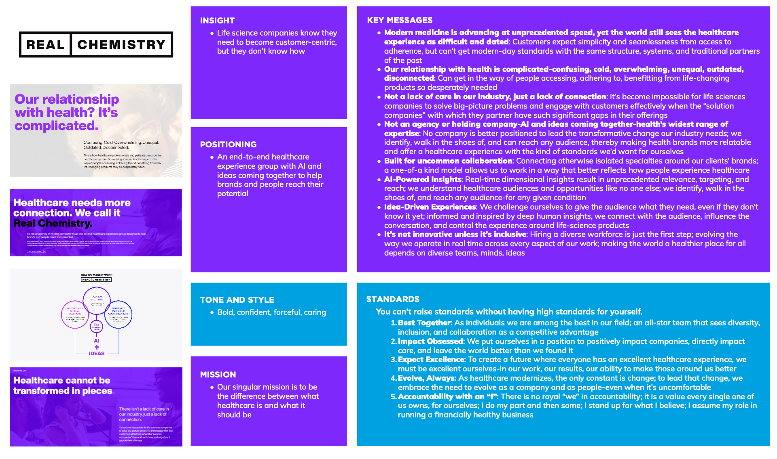

Slide 25
BIOS
25

Slide 26
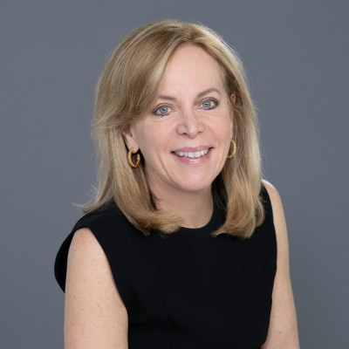
CO-FOUNDER
Cindy Machles, CEO
Cindy began her career in market research at Revlon, followed by product management at Clorox and Johnson & Johnson, before moving over to the agency side to start and run companies for WPP. At WPP, Cindy founded BrandEdge, the first branding agency focused entirely on the healthcare industry. Then, in 2014, she and long-term collaborator Alan Rothenberg launched Glue as a more strategic, innovative, nimble, and accountable agency.
Cindy has a BS summa cum laude from Boston University’s College of Communication and an MBA from the University of Chicago’s Booth School of Business. She was trained in facilitation at the Harry L Davis Center for Leadership, which is also part of Chicago Booth.
Cindy sits on the alumni board of the Kennedy Children’s Center, is a founding member of the Chicago Booth Angels Network, and mentors start-ups through the world-renowned Polsky Center, providing guidance on a range of needs, from market research to communications strategy to pricing and forecasting to tactical execution.
Glue has been recognized as a top-20 NYC agency since 2017, and in 2022, Cindy herself was recognized as a top 100 innovator and entrepreneur.
26

Slide 27
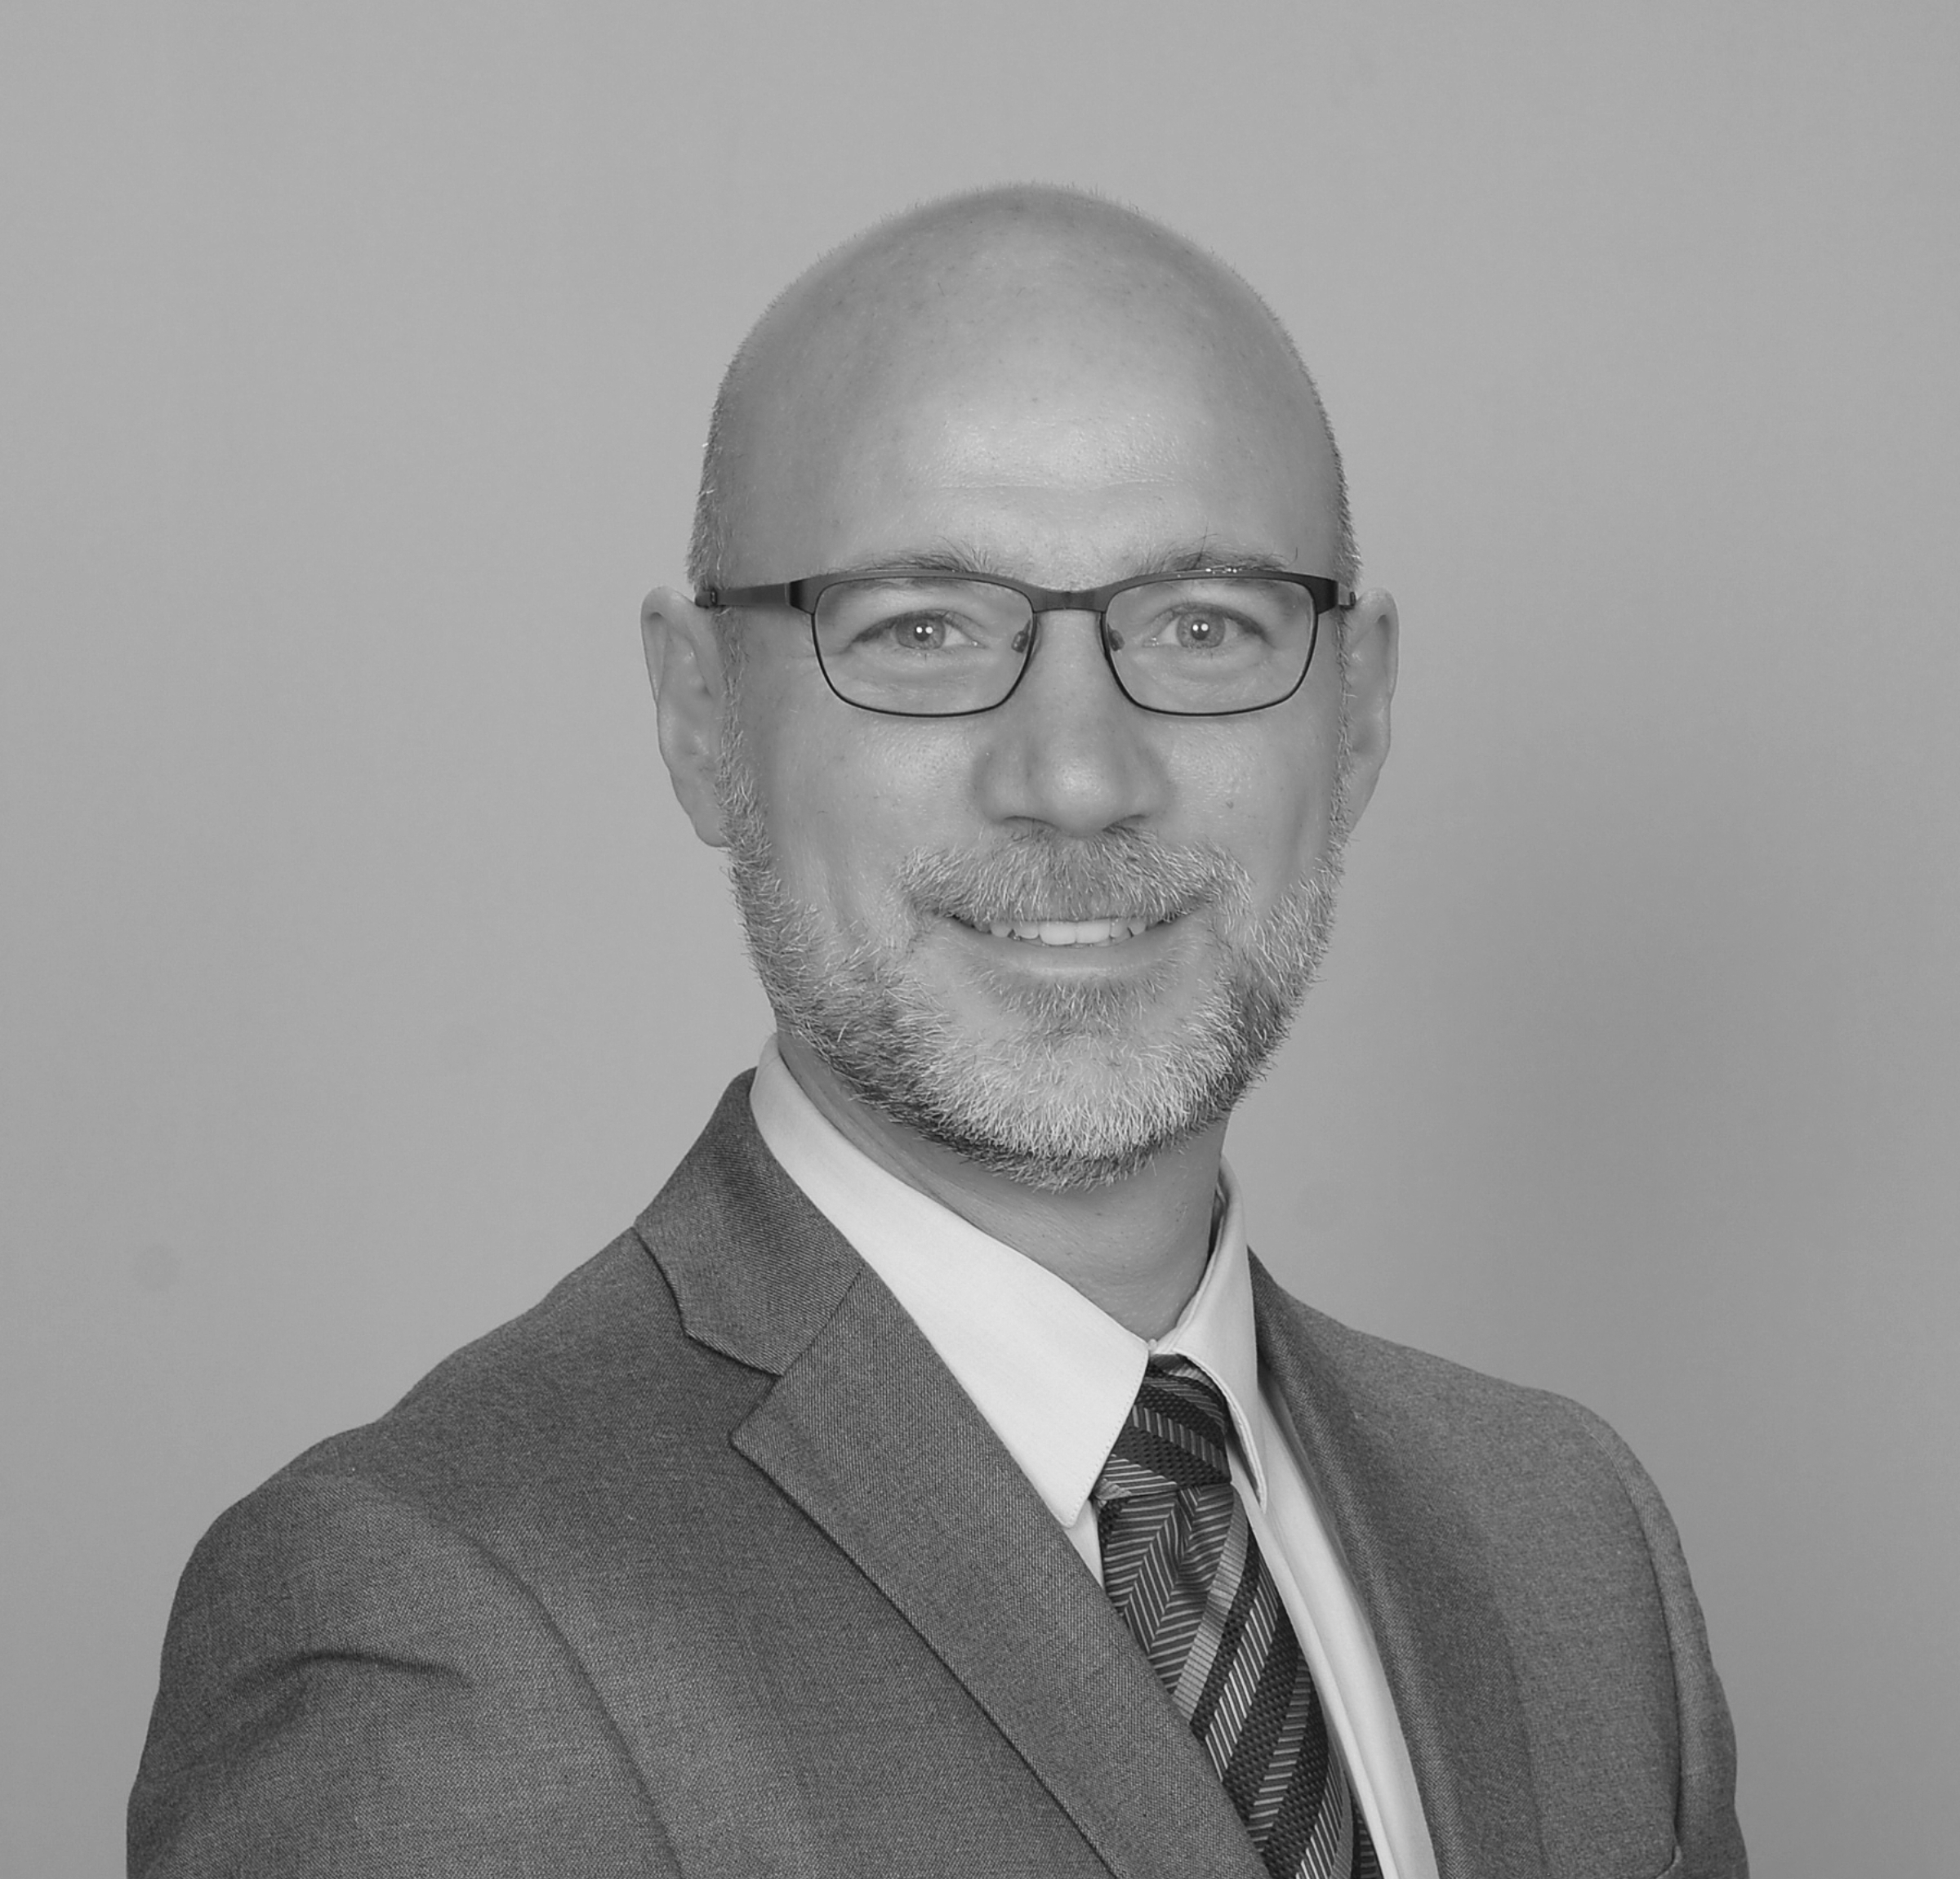
research DIRECTOR
Miklos Kremser, Analytics Team Leader
Miklos started his career at Nielsen's Centers of Excellence group, managing analytics projects for Procter & Gamble's various brands. Miklos has extensive experience in the pharmaceutical and healthcare industries, both B2B and B2C, where he is highly regarded for his insights into patterns of customer behavior, forecasting optimization, pricing, and other key drivers of brand performance. He is an expert at setting up performance simulators, optimization models, and dashboards in Tableau and Domo, which Miklos highly values for their drill-down capabilities in integrating disparate data sources.
Miklos’ technical expertise includes machine learning, data reduction, data segmentation, and especially choice-based techniques. He has also successfully used several regression techniques to predict the impact of multi-channel promotional activities on sales performance.
Miklos holds an MBA from The University of Iowa and a BA degree from Brigham Young University. Miklos is part of the Board of Advisors to Michigan State University's graduate market research program.
27

